Slide 1
3.2 Input and output devices
Output devices

Slide 2

Output devices
Output device Any device that can take data stored in digital form and convert it into another form humans can process such as sound, images or vibrations.

Slide 3
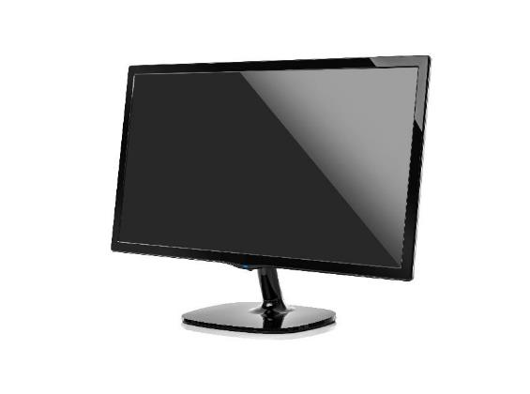
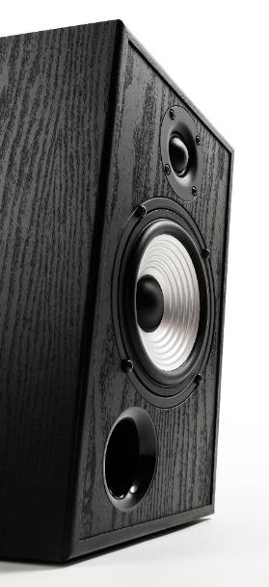
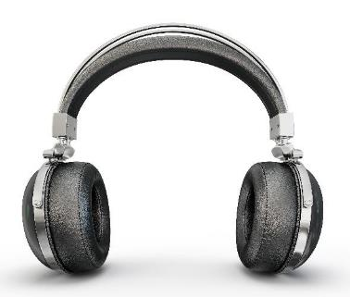
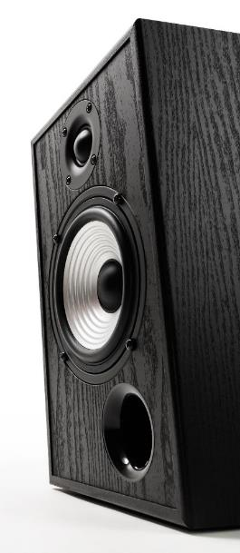
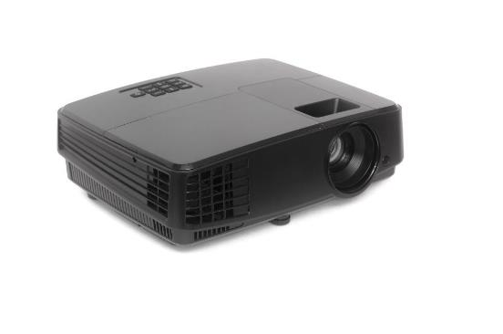
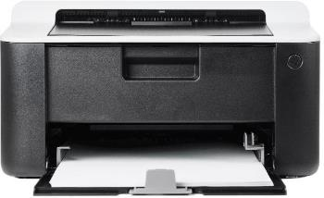
Examples of output devices

Slide 4
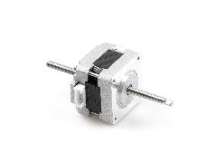
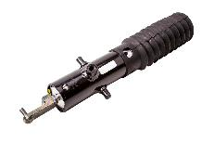


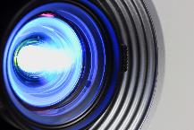
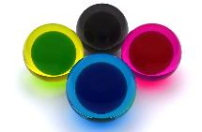


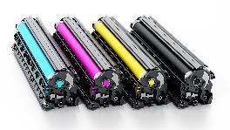
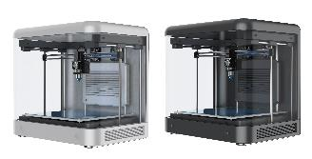
Specific output devices you need to know about for the exam
Actuator |  | Light-emitting diode (LED) screen
Digital light processing (DLP) projector |  | Liquid crystal display (LCD) projector/screen
Inkjet printer |  | Speaker
Laser printer |  | 3D printer

Slide 5

A note from the exam board
This section of the syllabus has been greatly simplified for exams taking place from 2023 onwards.
In the old syllabus, candidates needed to know details of how each output device operates – for example, how a laser printer actually replicates a digital image on paper.
Now, candidates only need to know:
what each device does;
why it does it; and
when it might be used.
There are still many textbooks, revision books and online videos that go into depth about how each device physically functions – you will not be examined on this.

Slide 6
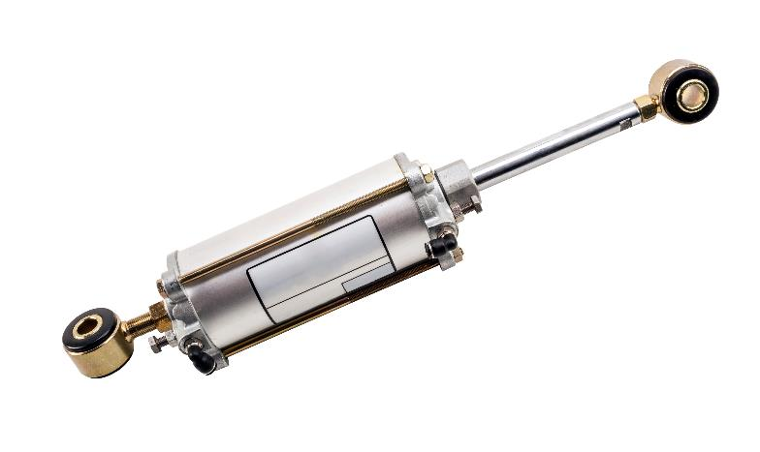
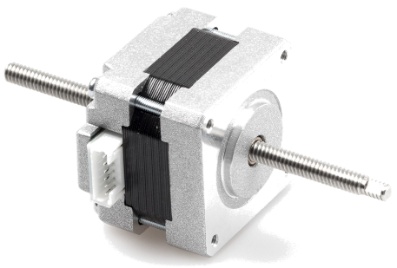
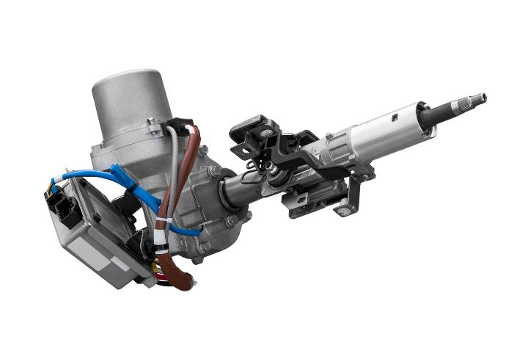
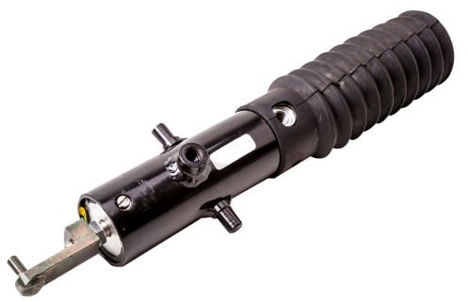
Actuator
What does it do?
Actuators come in a variety of shapes and sizes. Each version is purpose-built for a specific function, but they essentially all achieve the same goal, which is to carry out some sort of physical movement.

Slide 7
Actuator
What does it do?
Actuators come in a variety of shapes and sizes. Each version is purpose-built for a specific function, but they essentially all achieve the same goal, which is to carry out some sort of physical movement.
What is it typically used for?
Starting and stopping a pump or flow control device.
Opening and closing an automatic door.
Turning a wheel.
Opening and closing a valve.
Starting and stopping a conveyer belt.
Operating an aircraft’s wing flaps.

Slide 8
Actuator
What does it do?
Actuators come in a variety of shapes and sizes. Each version is purpose-built for a specific function, but they essentially all achieve the same goal, which is to carry out some sort of physical movement.
What is it typically used for?
Starting and stopping a pump or flow control device.
Opening and closing an automatic door.
Turning a wheel.
Opening and closing a valve.
Starting and stopping a conveyer belt.
Operating an aircraft’s wing flaps.
Why is it required?
Actuators are commonly used in conjunction with a motor to translate digital signals into actual, real-world movement of physical objects in all manner of ways.
They are also often used with sensors to control many kinds of mechanisms.

Slide 9
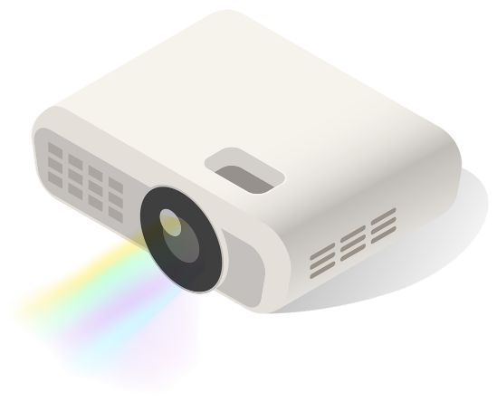


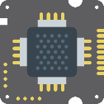
Digital light processing (DLP) projector
What does it do?
DLP systems use millions of micro-mirrors arranged in a matrix grid and placed on a small microchip within the projector itself. White light is then shone through a rotating colour filter to produce the image, while an angled mirror changes the colour intensity.
White light
Condensing lens
Colour filter
Shaping lens
DMD chip
Lens
Screen

Slide 10
Digital light processing (DLP) projector
What does it do?
DLP systems use millions of micro-mirrors arranged in a matrix grid and placed on a small microchip within the projector itself. White light is then shone through a rotating colour filter to produce the image, while an angled mirror changes the colour intensity.
What is it typically used for and why is it required?
Projecting a computer output onto a wall, whiteboard, projection screen, etc.
Personal/home and professional settings.

Slide 11
Digital light processing (DLP) projector
What does it do?
DLP systems use millions of micro-mirrors arranged in a matrix grid and placed on a small microchip within the projector itself. White light is then shone through a rotating colour filter to produce the image, while an angled mirror changes the colour intensity.
What is it typically used for and why is it required?
Projecting a computer output onto a wall, whiteboard, projection screen, etc.
Personal/home and professional settings.
Advantages over LCD projectors:
Higher contrast ratios.
Smoother video.
Smaller, lighter and more portable.
Better suited to dusty or smoky atmospheres.

Slide 12
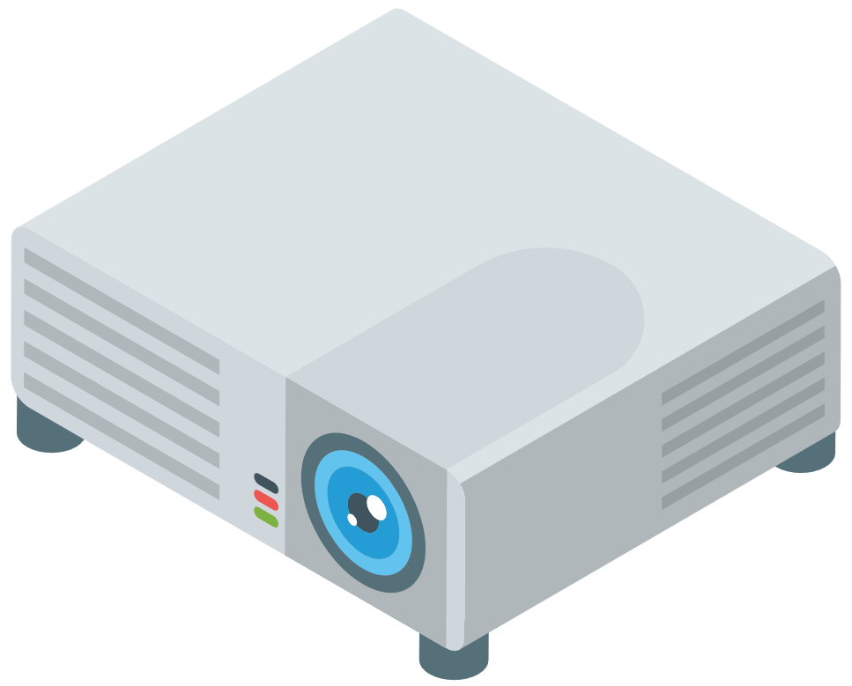

Liquid crystal display (LCD) projector
What does it do?
LCD projectors use three mirror filters to separate an image into its red, green and blue wavelengths. These images are then passed through a prism and recombined. Finally, the full colour image is passed through a lens and projected.
Screen
Lens
Mirror
Mirror
Prism
LCD
Light source
Dichromic mirrors

Slide 13
Liquid crystal display (LCD) projector
What does it do?
LCD projectors use three mirror filters to separate an image into its red, green and blue wavelengths. These images are then passed through a prism and recombined. Finally, the full colour image is passed through a lens and projected.
What is it typically used for and why is it required?
Projecting a computer output onto a wall, whiteboard, projection screen, etc.
Personal/home and professional settings.

Slide 14
Liquid crystal display (LCD) projector
What does it do?
LCD projectors use three mirror filters to separate an image into its red, green and blue wavelengths. These images are then passed through a prism and recombined. Finally, the full colour image is passed through a lens and projected.
What is it typically used for and why is it required?
Projecting a computer output onto a wall, whiteboard, projection screen, etc.
Personal/home and professional settings.
Advantages over DLP projectors:
Sharper image.
Better colour reproduction.
Typically less expensive.
Quieter operation.
Lower power usage and heat production.

Slide 15
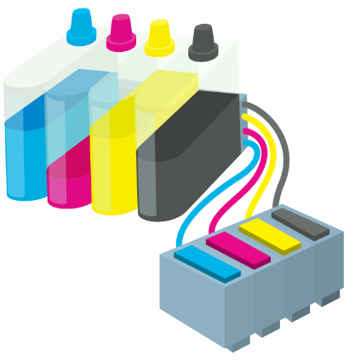
Inkjet printer
What does it do?
Inject printers force tiny droplets of liquid ink though very fine nozzles onto a sheet of paper to replicate a digital document or image.

Slide 16
Inkjet printer
What does it do?
Inject printers force tiny droplets of liquid ink though very fine nozzles onto a sheet of paper to replicate a digital document or image.
What is it typically used for?
Mostly used for small-scale print jobs.
Usually cheaper and smaller, so they are popular for personal use.
Excellent for printing out high-quality photos, especially when used with specialist photo paper.

Slide 17
Inkjet printer
What does it do?
Inject printers force tiny droplets of liquid ink though very fine nozzles onto a sheet of paper to replicate a digital document or image.
What is it typically used for?
Mostly used for small-scale print jobs.
Usually cheaper and smaller, so they are popular for personal use.
Excellent for printing out high-quality photos, especially when used with specialist photo paper.
Why is it required?
Even now, in this age of technology, there is still a need to produce physical copies of information stored in an electronic format.
Printouts or hard copies can be easily transported and viewed at any time without the need for an electronic device or internet connection.

Slide 18
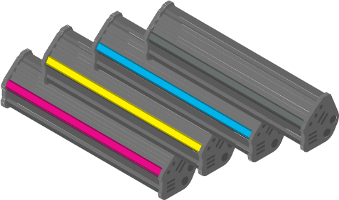
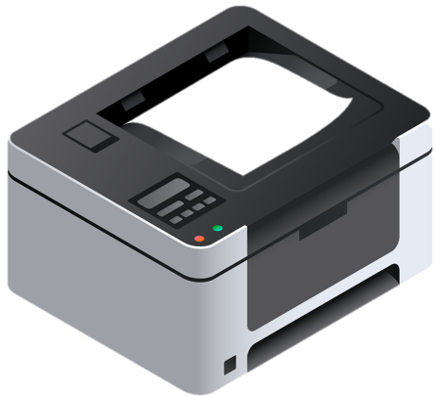
Laser printer
What does it do?
Laser printers use toner cartridges, which contain powdered, electro-optically charged ink. Using a laser, a mirror image of the printer page is drawn onto a drum by creating negatively charged areas. The drum then picks up the positively charged ink particles and bonds them to the paper using heat.

Slide 19
Laser printer
What does it do?
Laser printers use toner cartridges, which contain powdered, electro-optically charged ink. Using a laser, a mirror image of the printer page is drawn onto a drum by creating negatively charged areas. The drum then picks up the positively charged ink particles and bonds them to the paper using heat.
What is it typically used for?
High-quality, inexpensive printing.
Very fast and accurate for non-colour documents and images.
Lower running cost per page compared to an inkjet printer.
Often found in schools and offices.

Slide 20
Laser printer
What does it do?
Laser printers use toner cartridges, which contain powdered, electro-optically charged ink. Using a laser, a mirror image of the printer page is drawn onto a drum by creating negatively charged areas. The drum then picks up the positively charged ink particles and bonds them to the paper using heat.
What is it typically used for?
High-quality, inexpensive printing.
Very fast and accurate for non-colour documents and images.
Lower running cost per page compared to an inkjet printer.
Often found in schools and offices.
Why is it required?
Even now, in this age of technology, there is still a need to produce physical copies of information stored in an electronic format.
Printouts or hard copies can be easily transported and viewed at any time without the need for an electronic device or internet connection.

Slide 21

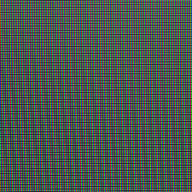
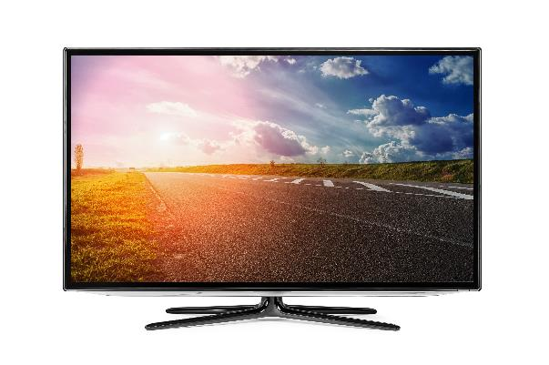
Liquid crystal display (LCD) screen
What does it do?
Liquid crystal displays (LCDs) are made up of millions of tiny liquid crystals. These crystals form a matrix of pixels, which can be affected by changes in applied electric fields. LCD screens require a form of backlighting, often provided by a fluorescent lamp or LEDs.

Slide 22
Liquid crystal display (LCD) screen
What does it do?
Liquid crystal displays (LCDs) are made up of millions of tiny liquid crystals. These crystals form a matrix of pixels, which can be affected by changes in applied electric fields. LCD screens require a form of backlighting, often provided by a fluorescent lamp or LEDs.
What is it typically used for?
TVs, monitors, laptops, mobile devices, etc.
Gradually being phased out in favour of newer technologies like LED and OLED.

Slide 23
Liquid crystal display (LCD) screen
What does it do?
Liquid crystal displays (LCDs) are made up of millions of tiny liquid crystals. These crystals form a matrix of pixels, which can be affected by changes in applied electric fields. LCD screens require a form of backlighting, often provided by a fluorescent lamp or LEDs.
What is it typically used for?
TVs, monitors, laptops, mobile devices, etc.
Gradually being phased out in favour of newer technologies like LED and OLED.
Why is it required?
We need to be able to output digital information in a visual way.
Although display technology is constantly evolving, there will probably always be a need for screens in some form.

Slide 24
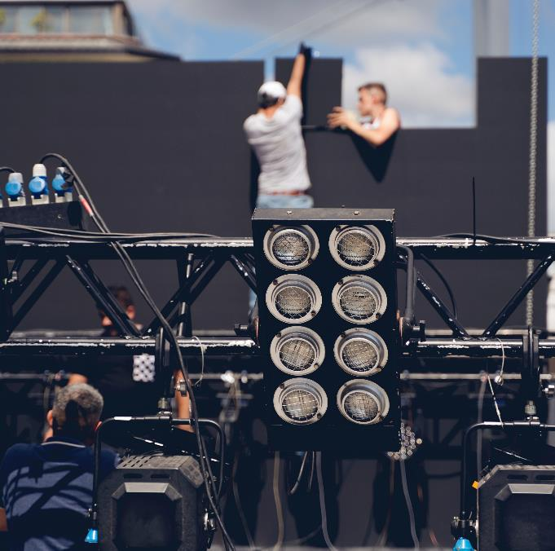
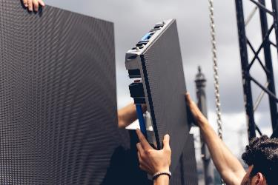
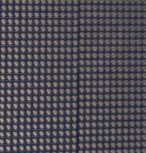
Light-emitting diode (LED) screen
What does it do?
These displays use tiny light-emitting diodes (LEDs) to produce a bright image almost instantly without the need for any additional backlighting.

Slide 25
Light-emitting diode (LED) screen
What does it do?
These displays use tiny light-emitting diodes (LEDs) to produce a bright image almost instantly without the need for any additional backlighting.
What is it typically used for?
Replacing LCD displays in more and more situations including TVs, monitors, laptops and mobile devices.
Multiple LED screens can be joined together, making them ideal for very large displays used in concerts, festivals and sporting events.

Slide 26
Light-emitting diode (LED) screen
What does it do?
These displays use tiny light-emitting diodes (LEDs) to produce a bright image almost instantly without the need for any additional backlighting.
What is it typically used for?
Replacing LCD displays in more and more situations including TVs, monitors, laptops and mobile devices.
Multiple LED screens can be joined together, making them ideal for very large displays used in concerts, festivals and sporting events.
Why is it required?
LED technology is generally considered better than LCD because it:
Offers better image quality and viewing angles.
Has a longer lifespan.
Requires no additional backlighting, so it’s thinner and lighter.

Slide 27

Speaker
What does it do?
Essentially, a speaker is the counterpart to a microphone (an input device) and works in the opposite way.
A digital representation of sound is passed through a digital-to-analog convertor (DAC), which can then be further boosted by an amplifier before being passed to a speaker to create analog sound waves.

Slide 28
Speaker
What does it do?
Essentially, a speaker is the counterpart to a microphone (an input device) and works in the opposite way.
A digital representation of sound is passed through a digital-to-analog convertor (DAC), which can then be further boosted by an amplifier before being passed to a speaker to create analog sound waves.
What is it typically used for?
TV, film and video games
Live music
Music recording playback
Alarms

Slide 29
Speaker
What does it do?
Essentially, a speaker is the counterpart to a microphone (an input device) and works in the opposite way.
A digital representation of sound is passed through a digital-to-analog convertor (DAC), which can then be further boosted by an amplifier before being passed to a speaker to create analog sound waves.
What is it typically used for?
TV, film and video games
Live music
Music recording playback
Alarms
Why is it required?
Speakers provide us with a way to take digital sounds or recordings and output them in a form that can be heard by the human ear.

Slide 30
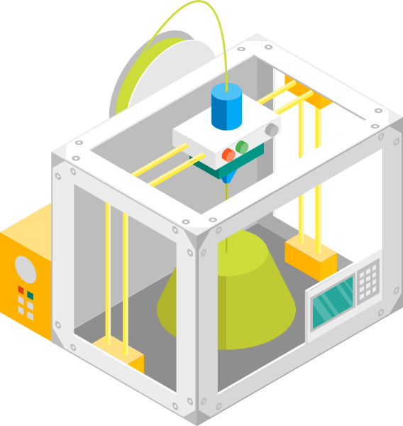
3D printer
What does it do?
Based on inkjet and laser printer technology, 3D printers work by depositing layers of material (often plastic) on top of each other to slowly build a 3D object. They can also use powered resin or metal, paper, ceramic, concrete – or even certain foods.

Slide 31
3D printer
What does it do?
Based on inkjet and laser printer technology, 3D printers work by depositing layers of material (often plastic) on top of each other to slowly build a 3D object. They can also use powered resin or metal, paper, ceramic, concrete – or even certain foods.
What is it typically used for?
Inexpensive prosthetics
Spare parts
Rapid prototyping
Personalised items

Slide 32
3D printer
What does it do?
Based on inkjet and laser printer technology, 3D printers work by depositing layers of material (often plastic) on top of each other to slowly build a 3D object. They can also use powered resin or metal, paper, ceramic, concrete – or even certain foods.
What is it typically used for?
Inexpensive prosthetics
Spare parts
Rapid prototyping
Personalised items
Why is it required?
3D printing allows us to produce real-world models of virtual objects created using computer-aided design (CAD) software.
It can create objects with intricate internal spaces and moving parts, and it provides a means of manufacturing with minimum waste.

Slide 33

Output devices
Output device: Any device that can take data stored in digital form and convert it into another form humans can process such as sound, images or vibrations.
Actuator: Allow physical movements to be carried out, often used in conjunction with a motor and sensor.
Opening and closing valves and doors.
Starting and stopping motorised objects like conveyor belts.
Digital light processing (DLP) projector: Millions of micro-mirrors arranged in a matrix grid, placed on a small microchip within the projector itself.
Higher contrast and smoother video than LCD projectors.
Small, light and portable.
Liquid crystal display (LCD) projector: Uses three separate mirror filters and a prism to create an image.
Provide a sharper image with better colour reproduction than LED projectors.
Quieter, use less power and produce less heat.
Inkjet printer: Uses liquid link forced through fine nozzles.
Produces high-quality photo prints.
Tends to be cheaper, popular for home setups.

Slide 34
Output devices
Laser printer: Uses dry powder fused onto paper using heat.
Very fast and accurate for bulk printing non-colour documents.
Lower running cost per page than inkjet printers.
Often used in schools and offices.
Liquid crystal display (LCD) screen: Made up of millions of liquid crystals, requires backlighting.
TVs, monitors, laptops.
Generally considered an older form of display technology.
Light-emitting diode (LED) screen: Uses tiny LEDs to produce bight images without the need for additional backlighting.
Superior picture quality compared to LCDs.
Slimmer and lighter.
Speaker: Converts digital representations of sound into analog waves that can be heard by the human ear.
TV, film, video games.
Live music, recording playback.
Alarms and sirens.
3D printer: Deposits layers of material to build a 3D object.
Usable materials include plastic, powdered metal and resin, paper, ceramic, concrete and some foods.
Used to produce prosthetics, spare parts, models and personalised items.

Slide 35
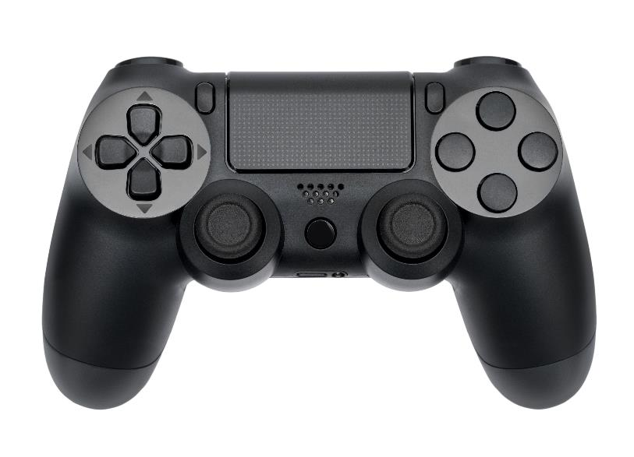
Blurring the lines
Is this gaming controller an input or output device?

Slide 36
Blurring the lines
It translates button presses and stick movements into digital signals.
So, it’s an input device… right?

Slide 37
Blurring the lines
Not exactly. Modern controllers also have built-in speakers and haptic feedback technology – these make it an output device as well.
As far as the exams are concerned, you can consider a game controller an input device primarily.
However, be aware that the lines can sometimes be blurry, so always be sure to justify your answer.

Slide 38
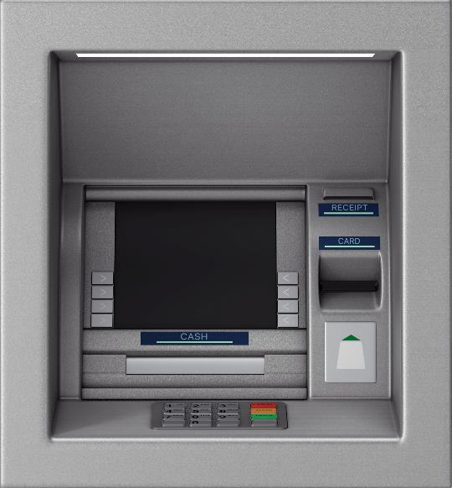


Appropriate devices for specific situations
What input and output devices might be used as part of this cashpoint system?

Slide 39
Appropriate devices for specific situations
What input and output devices might be used as part of this cashpoint system?
Input devices
Card reader
Keypad
Buttons
Camera

Slide 40
Appropriate devices for specific situations
What input and output devices might be used as part of this cashpoint system?
Input devices
Card reader
Keypad
Buttons
Camera
Output devices
Monitor
Printer
Speakers
Actuator/motor

Slide 41


